Slide 1


Hii,
Iam Siddhika
Welcome to Power BI Series
Part -80

Slide 2



I’m very excited to dive into this with you all!
Are you ready to enhance your data visualization skills?
We focus only few visuals...
Today Content
VISUALIZING DATA
CUSTOM VISUALS IN POWER BI (FEW MORE)
INFOGRAPHIC DESIGNER ADVANCE CARD

Slide 3


INFOGRAPHIC DESIGNER
check next slide..
Infographic Designer is a custom visual in Power BI that allows users to create visually appealing, infographic-style reports.
This visual combines data with images, icons, and text to create engaging and informative graphics that are easy to understand at a glance.
When to Use:
To present data in a more creative and visually engaging format.
When you want to combine multiple data points, icons, and text in a single visual.
For storytelling with data where design and aesthetics are as important as the information being conveyed.

Slide 4

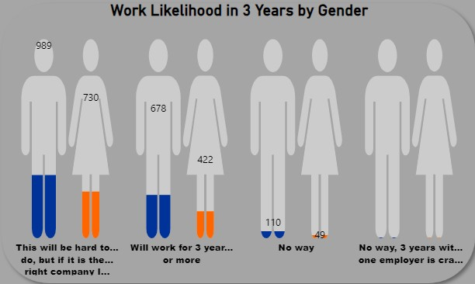
Purpose:To transform standard data visuals into infographic- style presentations.
To improve the visual appeal of reports and make data more accessible and understandable
Once you try
it

Slide 5


ADVANCE CARD
The Advance Card provides a more enhanced and flexible way of displaying single or multiple key metrics.
It offers additional customization options beyond the standard Card visual, allowing users to better format and display their key performance indicators (KPIs).
When to Use:
When you need to highlight key metrics with more control over the visual's appearance.
To display multiple metrics in a compact and visually appealing way.
When the default Card visual's formatting options are not sufficient for your needs.
check next
slide to see
the visual..

Slide 6
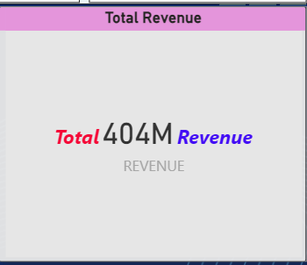
Purpose:To present important data points, such as total revenue, number of orders, or other KPIs, with advanced formatting options.
To make key metrics stand out in your reports or dashboards.
To customize the appearance of your metrics, including colors, fonts, and backgrounds, to better align with your report's design.
once go and try guys...
..

Slide 7


Thank you for joining me today to learn about Part -80 of Power BI!
Remember, Effective data visualization is crucial for turning data into meaningful insights and compelling narratives with Power BI.
Stay tuned for more insights and tips on Power BI in our next Series.
Follow

